Slide 1
Saline River Pizza
3650 Project
Tara, Rachael, Jay

Slide 2
Project Proposal
Client: Bruce Bauer
Company: Saline River Pizza
Project: Create an awesome pizza website!

Slide 3
Specifications
Logo/Design
Locate the Business
Products Sold
Submit Orders
Analytics

Slide 4

Logo/Design

Slide 5
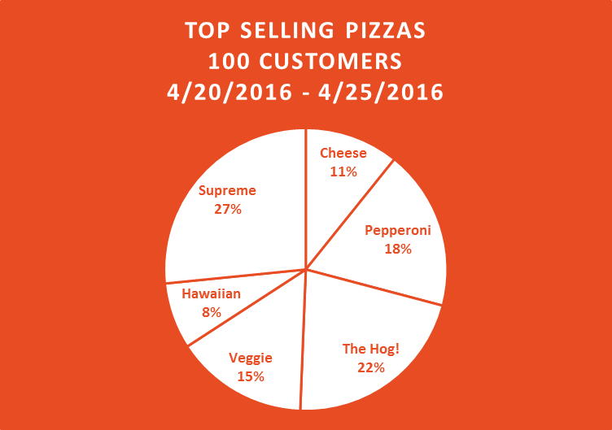
Charts

Slide 6
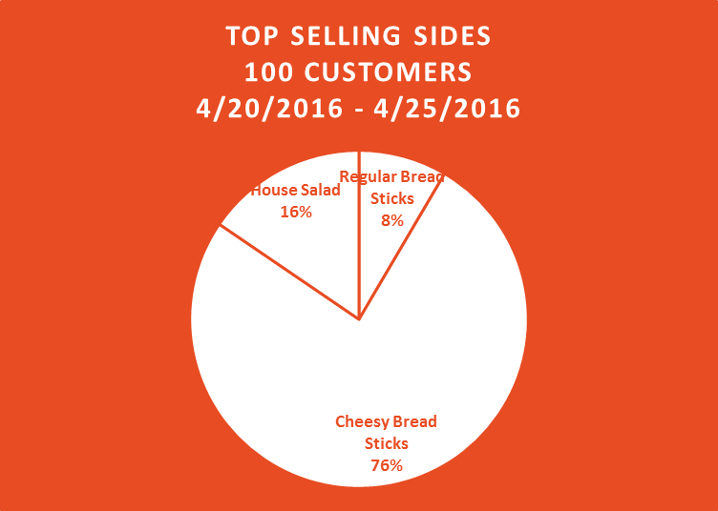
Charts

Slide 7
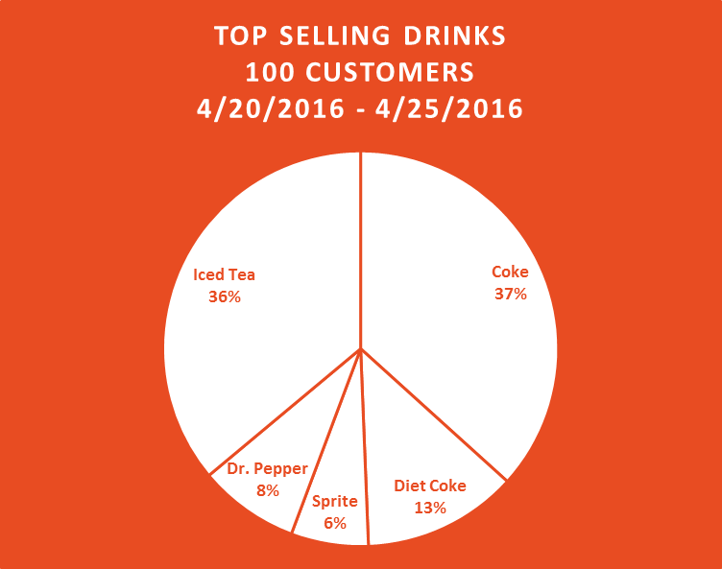
Charts

Slide 8
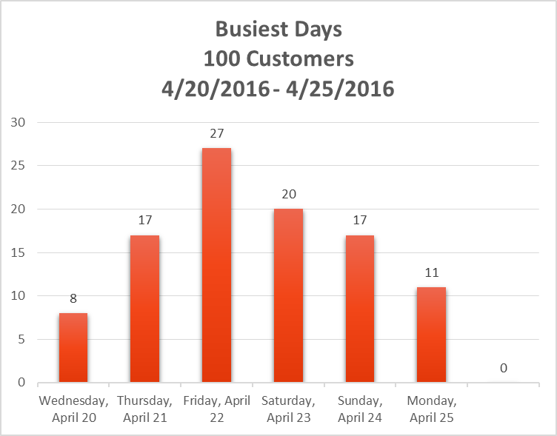
Charts

Slide 9
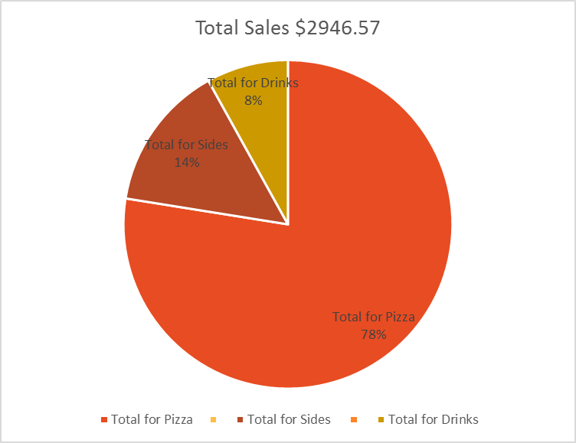
Charts

Slide 10
Looking Forward
Changes/Enhancement
Flexibility
Relationship

Slide 11
Thank You For Your Business

